Slide 1
UNIT - 02
Design-Life
The
UX
Cycle

Slide 2
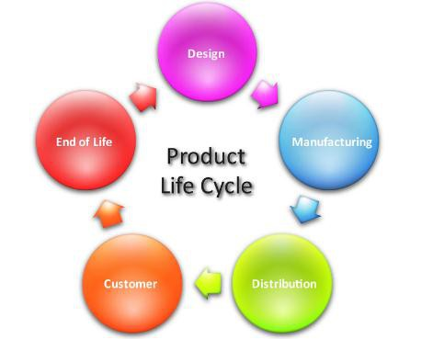
Life Cycle
A lifecycle is a structured framework consisting series of stages and corresponding of activities— such as analysis, design, implementation and
evaluation— the full
evolution of an interaction
design
or
a
complete
system
or
product.

Slide 3
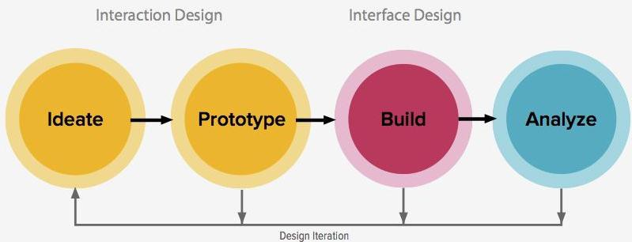
Iterative
An iterative process is one in which all or part is repeated for the purpose of exploring, fixing, or refining a design or the work product of any other
lifecycle activity. It is
the
“wash,
rinse,
and
repeat”
of
HCI.
characteristic

Slide 4
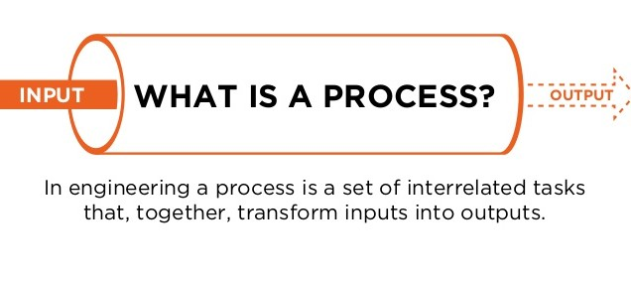
✓Process acts as a checklist for experts to make
sure they do not miss any important aspects of the problem in the heat of productivity.
✓A process helps designers answer questions such
as “Where
are
we now?”
and
“What
can/should
we
do
next?”

Slide 5
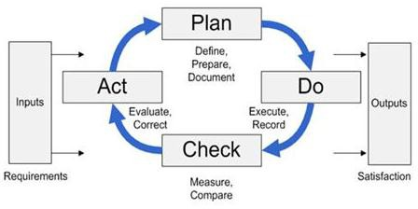
✓In other words, process provides a repeatable
formula
to
create
a
quality
product.

Slide 6
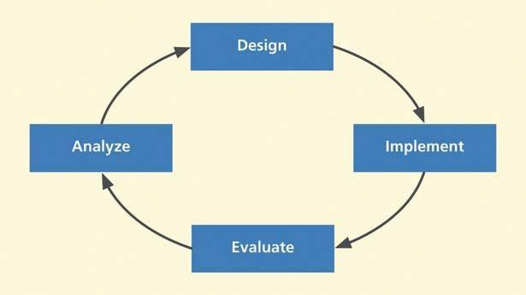
2.1
A
UX
PROCESS
LIFE CYCLE TEMPLATE
Universal abstract activity cycle of Analyze, Design, Implement, and Evaluate.

Slide 7
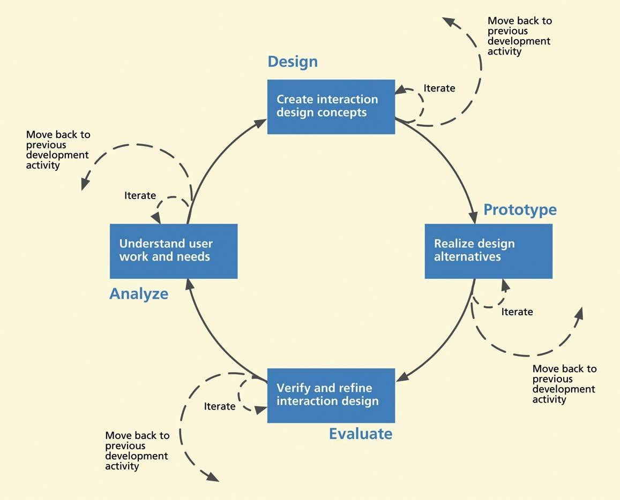
A
UX
PROCESS LIFECYCLE TEMPLATE

Slide 8
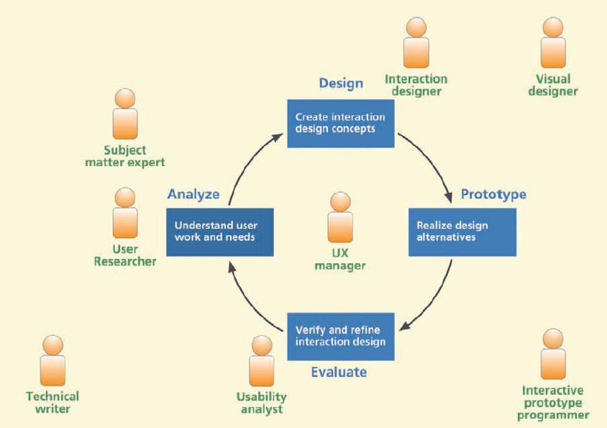

Slide 9
